Slide 1

STORYBOARD
60-SECOND WSP PROMOTIONAL FILM
Engineering Tomorrow | AI-Assisted Brand Film Concept for WSP
01 PROJECT OBJECTIVE
02 CREATIVE APPROACH
A cinematic 60-second concept demonstrating how engineering, advisory expertise, and AI-enabled production come together to communicate WSP's vision of shaping sustainable communities and resilient infrastructure.
Authentic engineering storytelling meets AI-assisted production. Every scene is chosen to visually reinforce its voice-over line, with AI applied strategically to accelerate production and visualise complex engineering ideas while keeping the film human-centred.
AI Generated
AI Enhanced
Stock Footage Enhanced
Hussein Masri

Slide 2
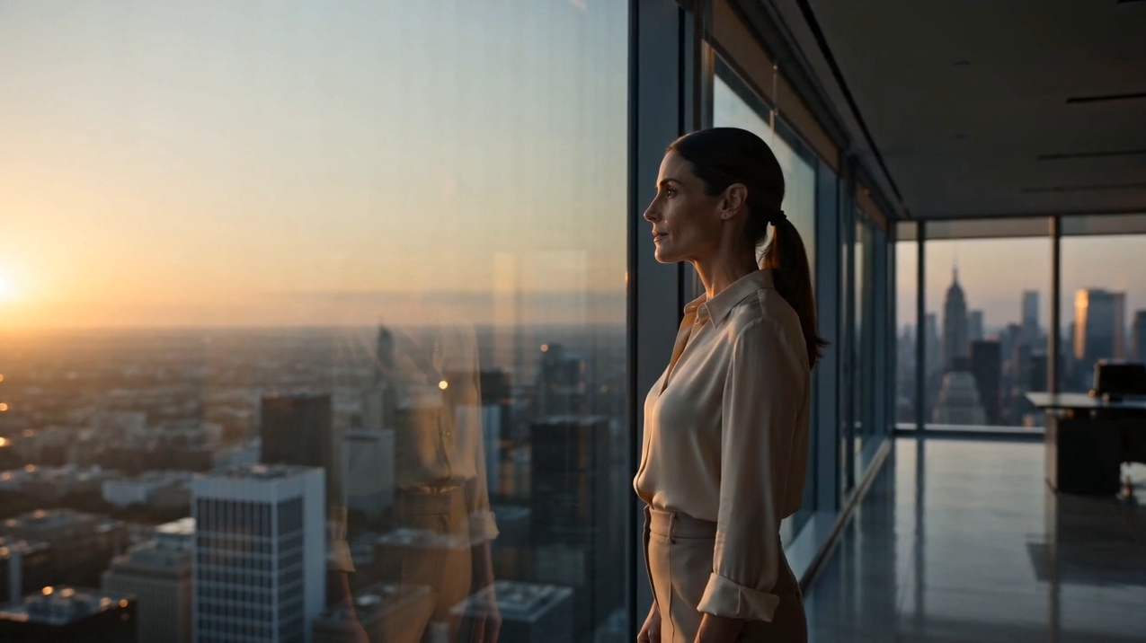
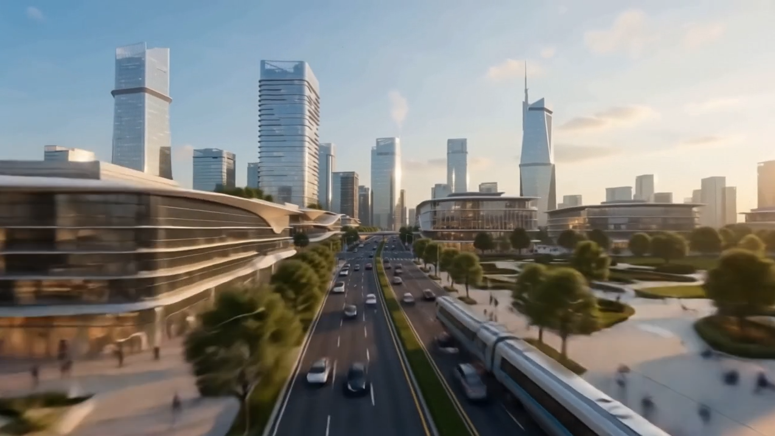
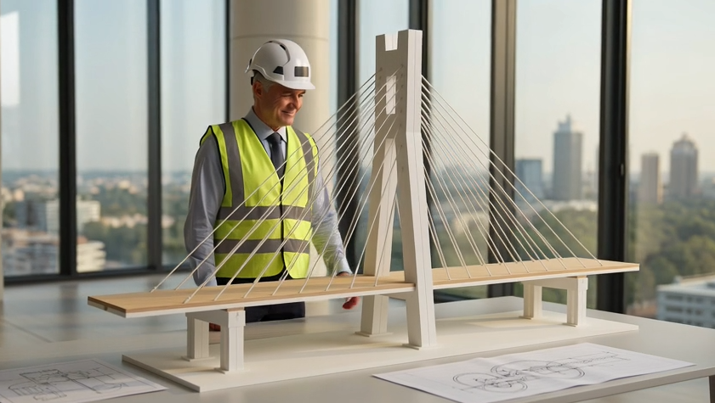
STORYBOARD
ACT I — UNDERSTANDING
SCENE 01
SCENE 02
SCENE 03
"At WSP, engineering begins with understanding."
"As cities grow and the world continues to change."
"The decisions we make today will shape how people live tomorrow."
VISUAL
A senior engineering leader overlooks the city at sunrise, reflecting before the day begins.
VISUAL
A cinematic aerial view reveals a modern city's integrated transit, public space, and evolving infrastructure.
VISUAL
An engineer studies a bridge scale model, evaluating the design before construction begins.
WHY
Opens on insight before action engineering starts with understanding people, place, and what's ahead.
WHY
Establishes the scale of growth and complexity that engineering must respond to.
WHY
Early design decisions carry long-term consequences; thoughtful planning shapes tomorrow.
AI Generated
AI Enhanced
Stock Footage Enhanced
Hussein Masri

Slide 3
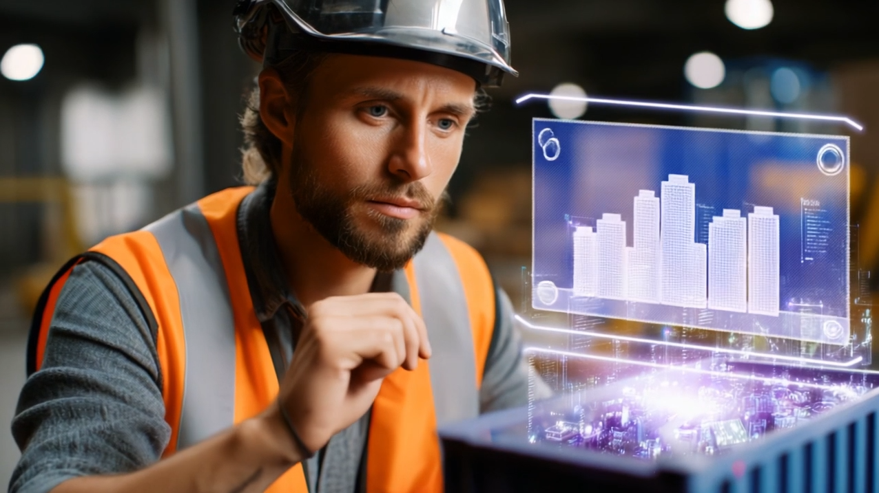
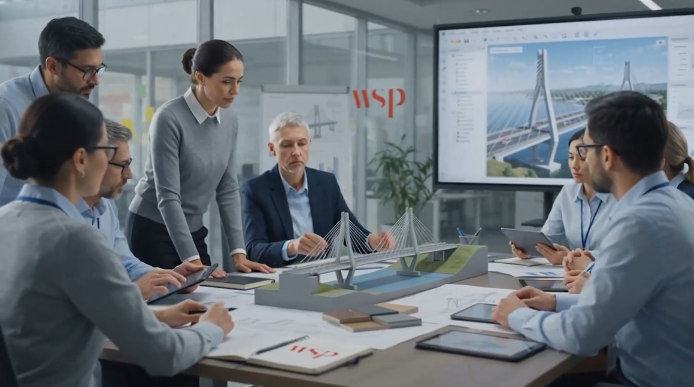
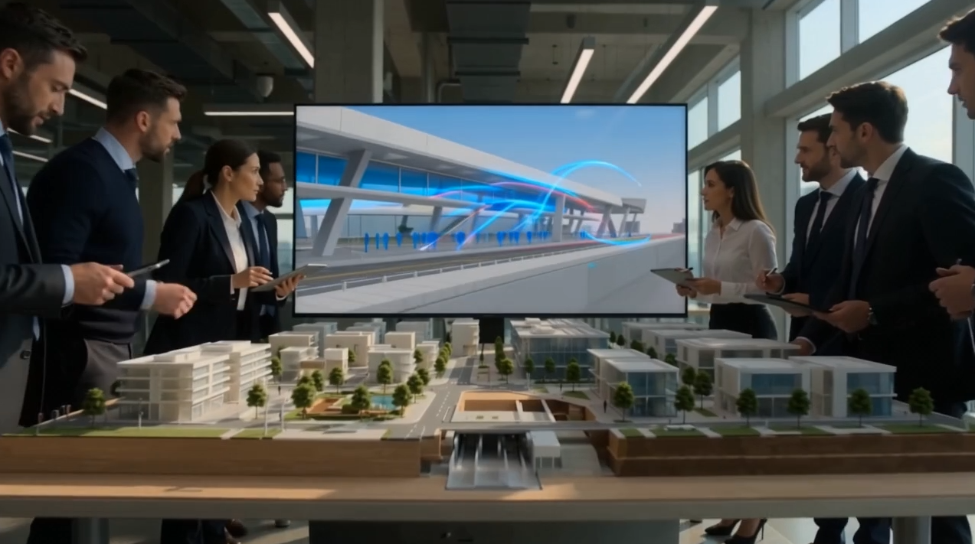
STORYBOARD
ACT II — INSIGHT & COLLABORATION
SCENE 04
SCENE 05
SCENE 06
"At WSP, engineering begins with understanding."
"Bringing together advisory expertise, science, data and technology to see challenges differently."
"To design resilient infrastructure."
VISUAL
An engineer interacts with a Digital Twin, analyzing a virtual city before construction begins.
VISUAL
A multidisciplinary team collaborates around a bridge model, reviewing a digital design on-screen.
VISUAL
An engineering team reviews a large-scale urban model against a live digital infrastructure simulation.
WHY
Understanding is built through analysis and visualization exploring scenarios before committing to reality.
WHY
Shows disciplines converging: technical, scientific, and digital expertise evaluated together.
WHY
Resilience is designed, not assumed, through collaboration and digital simulation before construction.
AI Generated
AI Enhanced
Stock Footage Enhanced
Hussein Masri

Slide 4
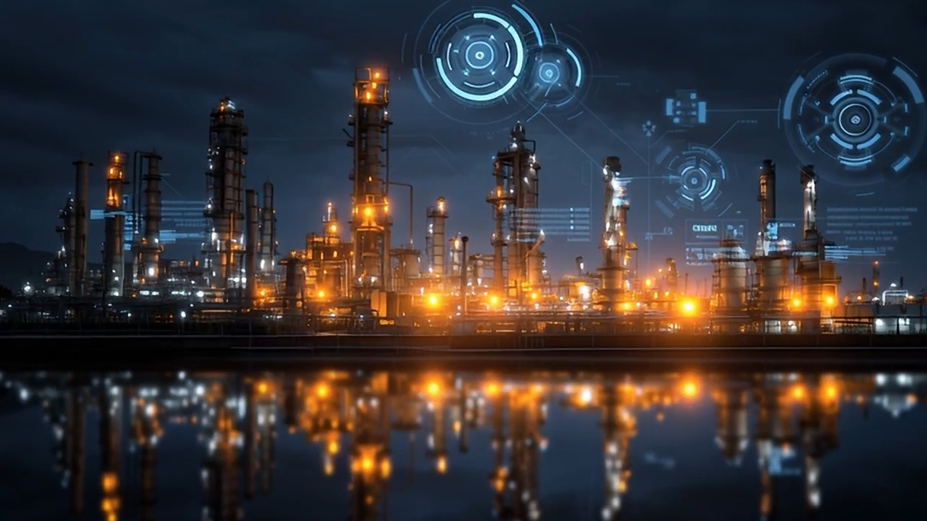
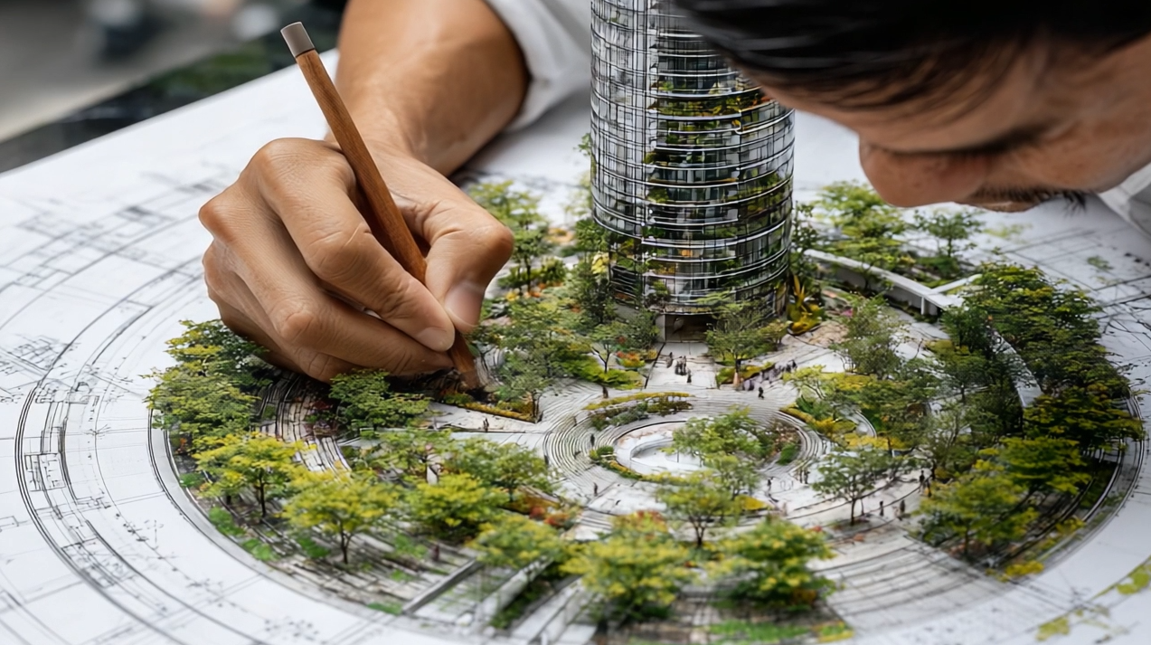
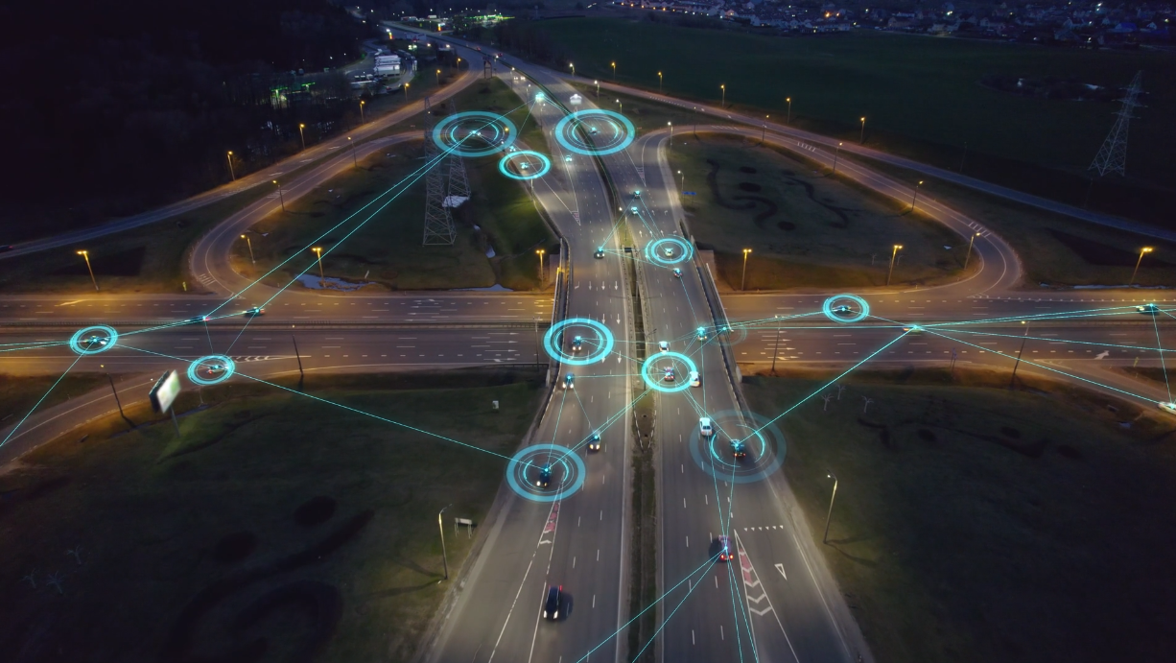
STORYBOARD
ACT III — SUSTAINABILITY AND INNOVATION
SCENE 07
SCENE 08
SCENE 09
"Protect natural resources."
"Create more sustainable places."
"And connect communities through smarter mobility, energy and the built environment."
VISUAL
A modern energy facility is monitored through intelligent digital overlays tracking environmental performance.
VISUAL
An architect develops a sustainable urban design, weaving green space and nature into the built form.
VISUAL
An aerial highway interchange is overlaid with intelligent digital connections, visualizing a smart network.
WHY
Technology in service of stewardship efficiency and environmental monitoring together.
WHY
Sustainable places begin at the drawing board: architecture and nature planned as one.
WHY
Makes the invisible visible: the connected intelligence behind safer, smarter transportation.
AI Generated
AI Enhanced
Stock Footage Enhanced
Hussein Masri

Slide 5
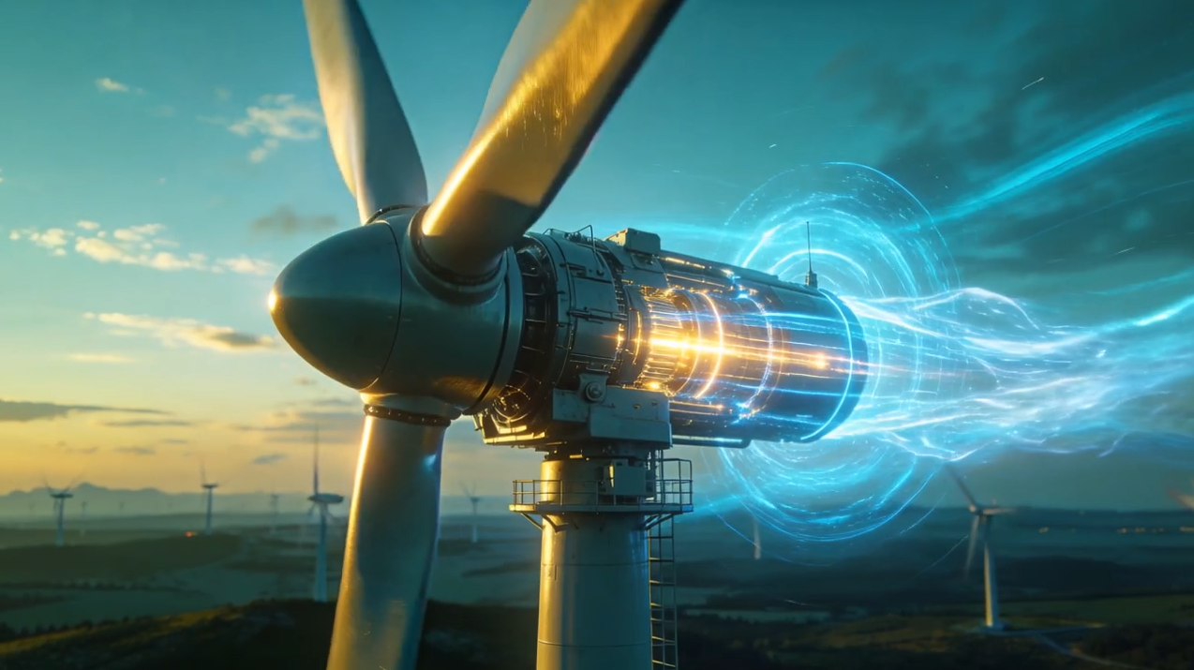
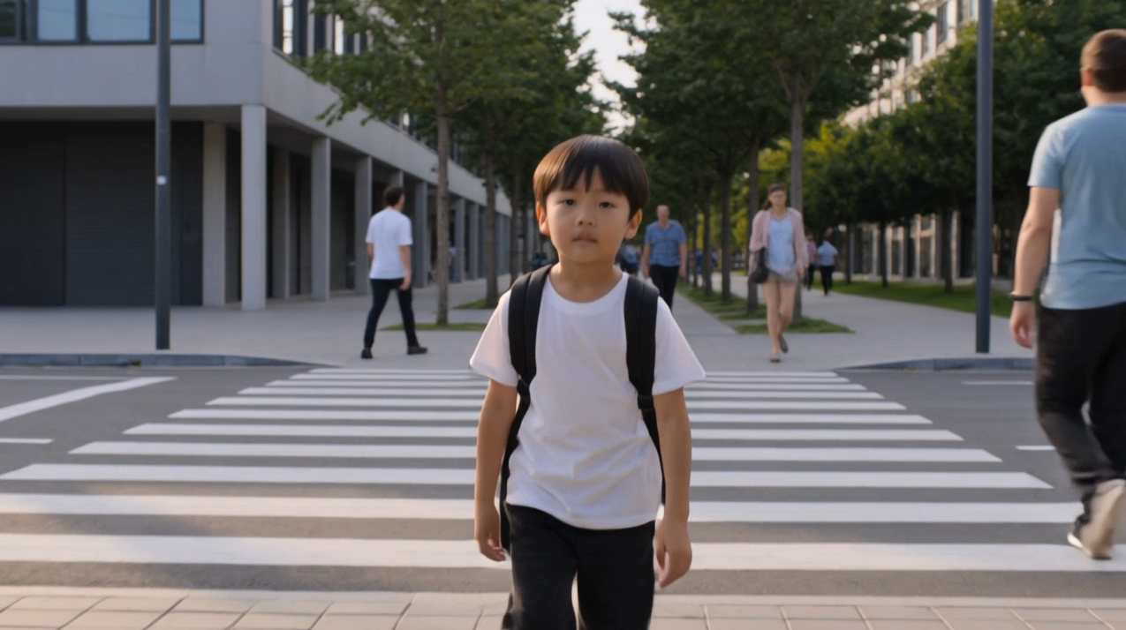
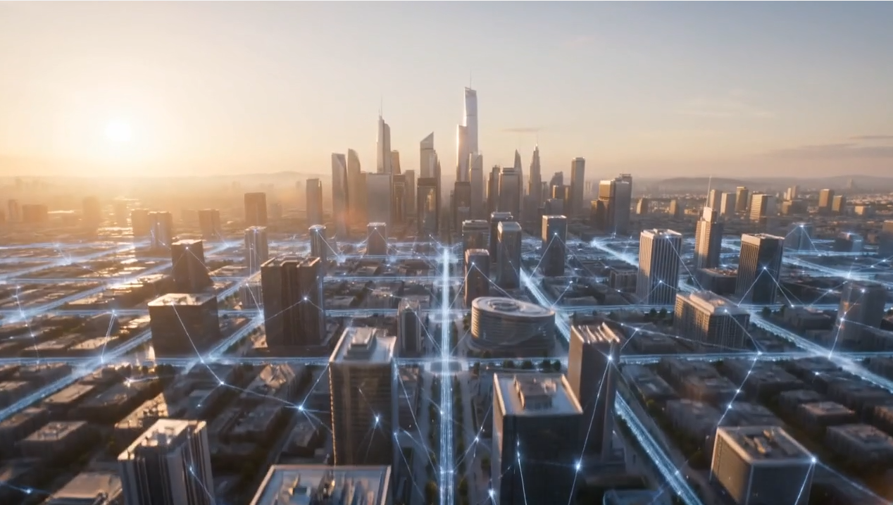
STORYBOARD
ACT IV — IMPACT AND SHAPING THE FUTURE
SCENE 10
SCENE 11
SCENE 12
"Energy and the built environment."
"Because progress is not measured only by what we build, but by the positive impact it creates for people and the planet."
"Turning possibility into lasting progress."
VISUAL
A wind turbine operates with subtle AI-powered energy-flow visualization woven into the frame.
VISUAL
A child walks safely through a vibrant, people-centered community of green space and everyday life.
VISUAL
A connected smart city comes to life through subtle digital infrastructure networks at dusk.
WHY
Renewable energy shown as integrated infrastructure, not a standalone icon.
WHY
Shifts focus from structures to people the true measure of engineering's success.
WHY
The closing image: innovation, collaboration, and infrastructure resolved into one skyline.
AI Generated
AI Enhanced
Stock Footage Enhanced
Hussein Masri

Slide 6
STORYBOARD
PRODUCTION APPROACH
STYLE
LOOK & FEEL
AI PRODUCTION TECHNIQUES
Cinematic Documentary
Human-Centered Storytelling
AI-Assisted Production
Engineering Visualization
Premium Corporate Film
Warm Natural Color Palette
Authentic Human Moments
Premium Architecture
Subtle AI Visualizations
Minimal Motion Graphics
AI Image & Video Generation
Digital Twin Visualisation
Generative Scene Expansion
AI Compositing & Cleanup
AI-Assisted Colour Matching
AI Voiceover
CREATIVE DIRECTION
The creative approach intentionally combines authentic documentary cinematography with AI-enhanced production. Rather than treating AI as a visual spectacle, it is woven throughout production to strengthen storytelling, accelerate content creation, and visualize complex engineering concepts resulting in a cinematic narrative where engineering, science, data, and technology come together to create meaningful impact for people and the planet.
Hussein Masri

Slide 7
THANK YOU

